Slide 1
Syllables
(g, h, i, j)

Slide 2
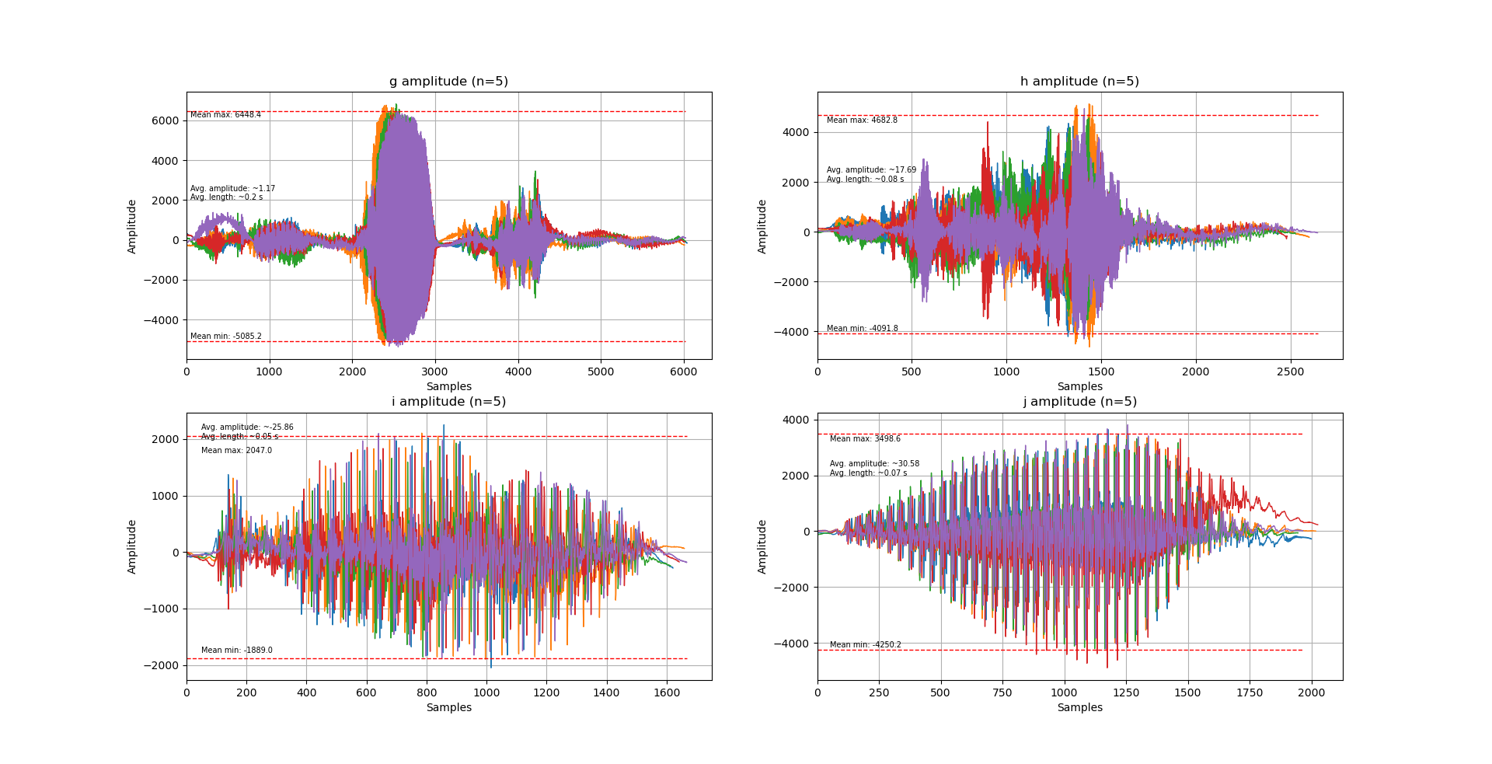
Raw Syllable
Highest max amplitude

Slide 3
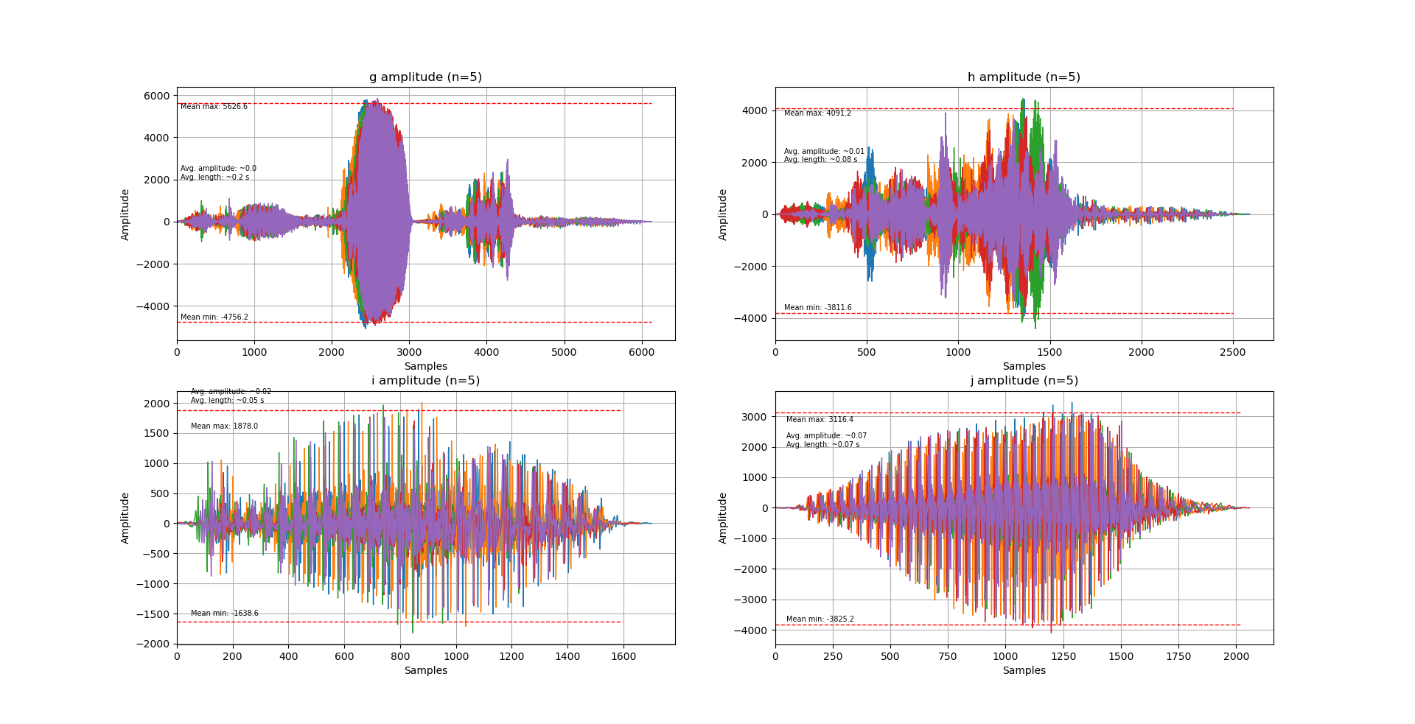
Filtered Syllable

Slide 4
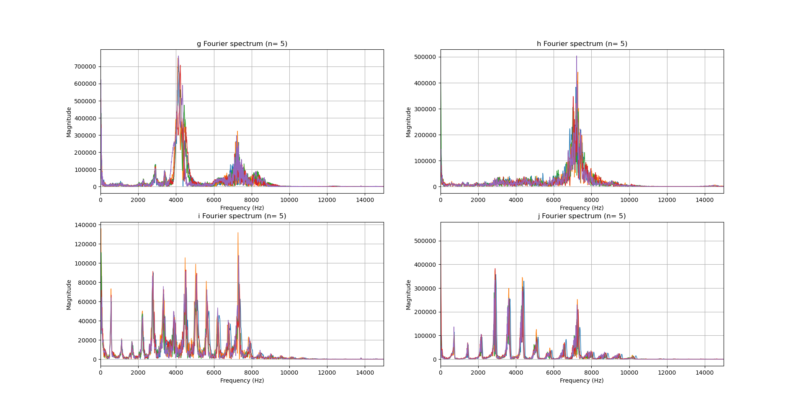
Raw Fourier
~4000 Hz
~7250 Hz
~7250 Hz
~7250 Hz
~7250 Hz

Slide 5
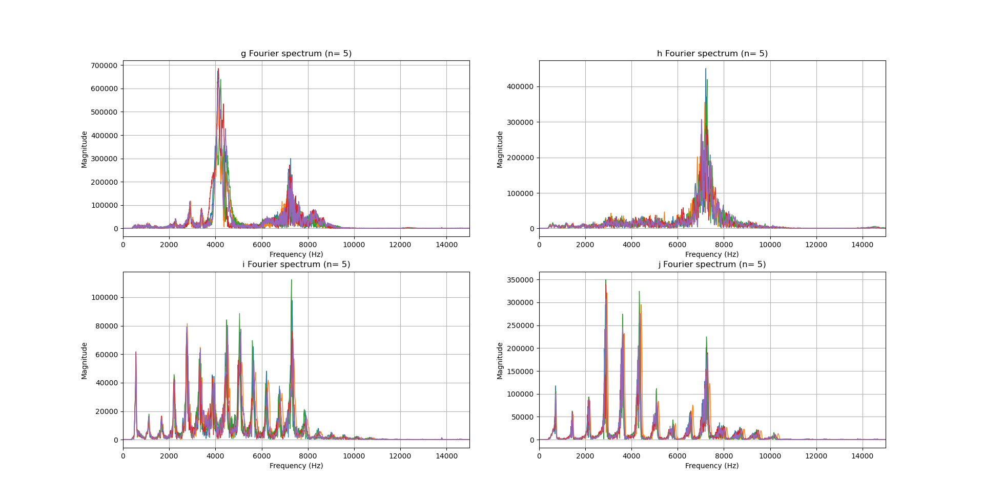
Filtered Fourier
~4000 Hz
~7250 Hz
~7250 Hz
~7250 Hz
~7250 Hz

Slide 6
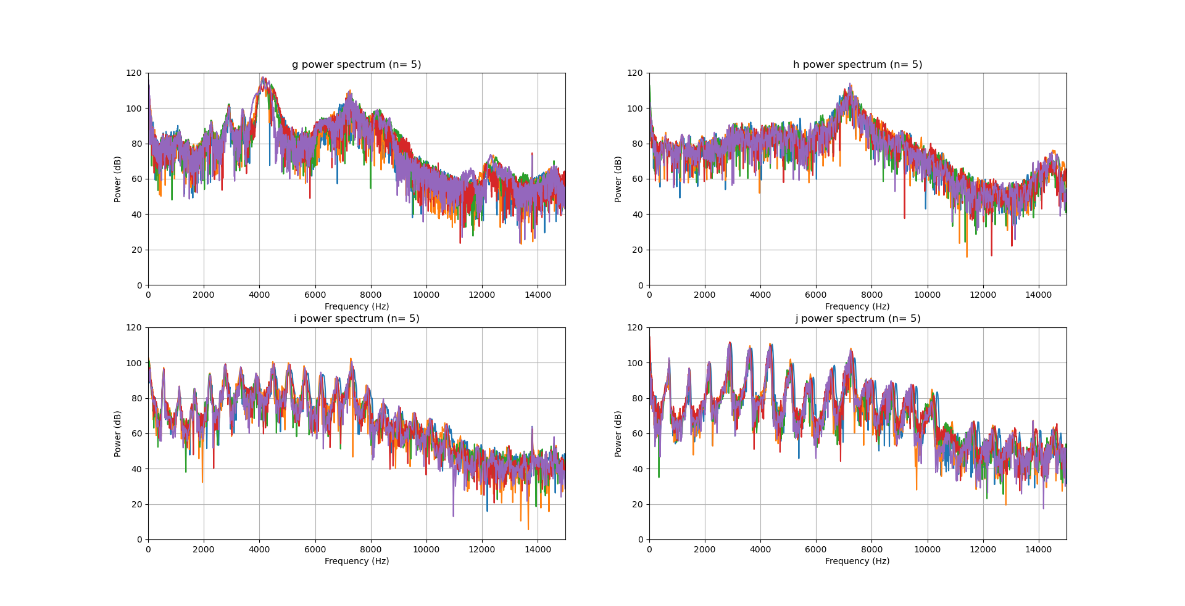
Raw Power

Slide 7
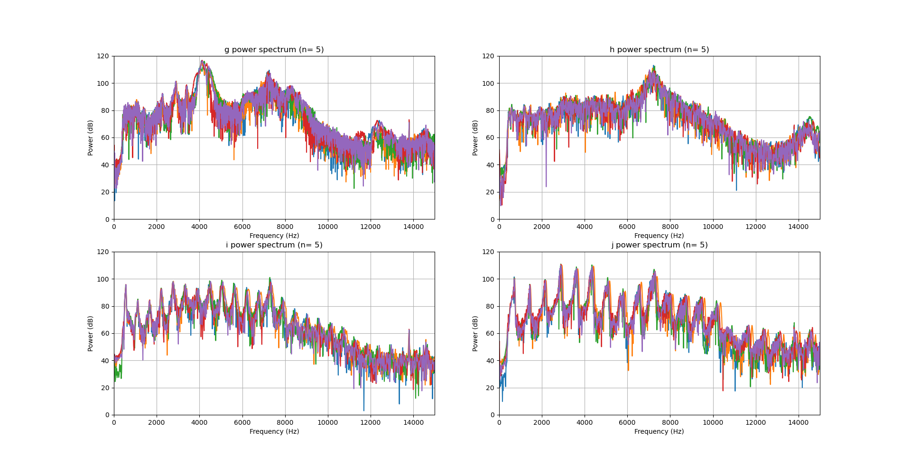
Filtered Power

Slide 8
Syllables Combined
(unfiltered)

Slide 9
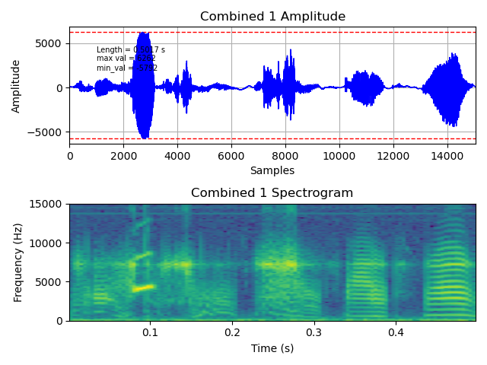
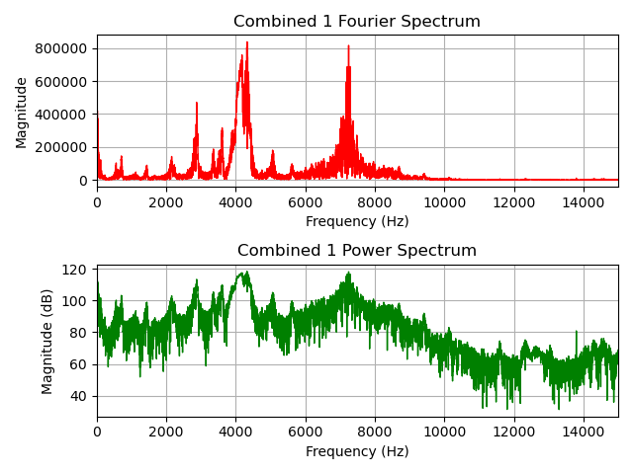
Combined 1
G + H peaks

Slide 10
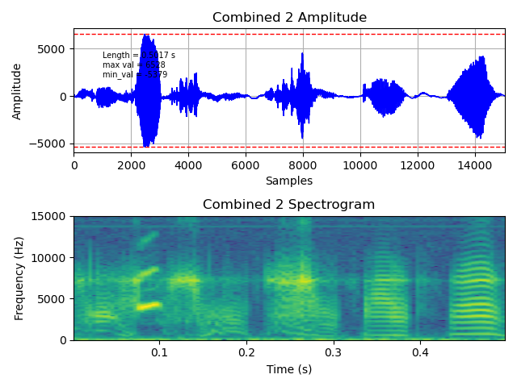
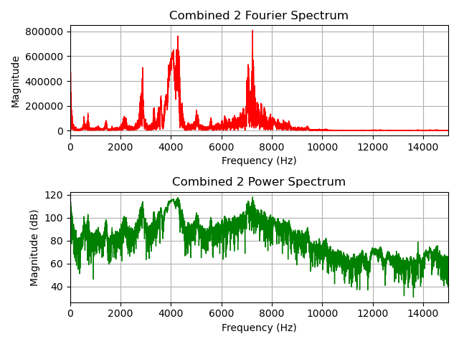
Combined 2
G + H peaks

Slide 11
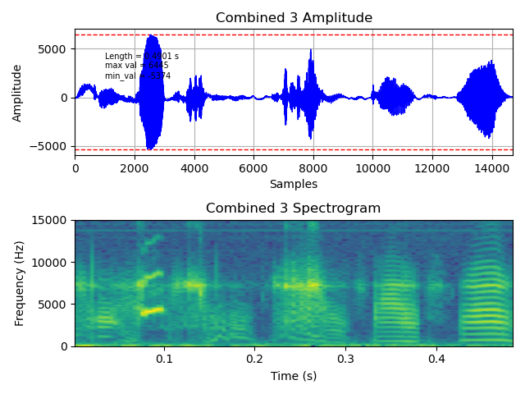
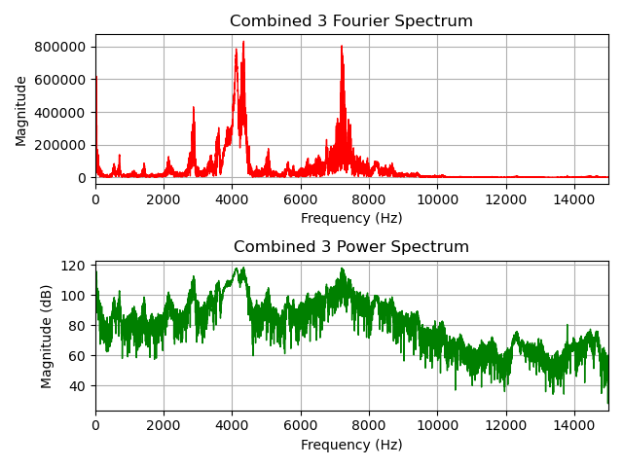
Combined 3
G + H peaks

Slide 12
Noise

Slide 13
Noise
Can vary in length
Mostly low frequency
Seems to have consistent peak at ~ 7250 Hz
Can affect amplitude differently

Slide 14
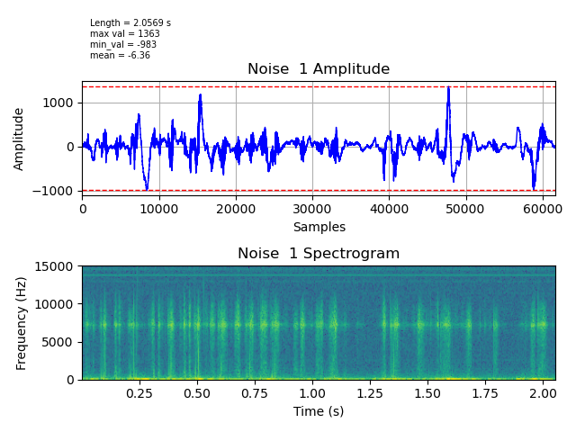
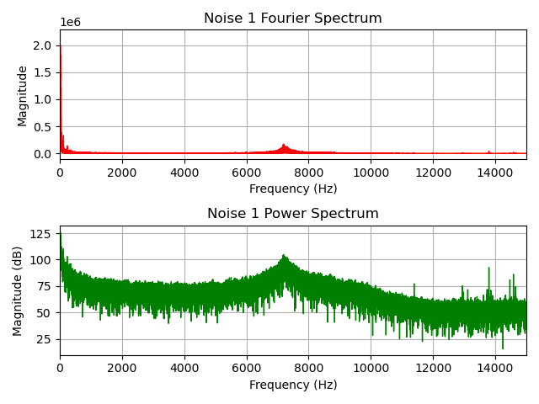
Noise 1:
Peak around ~7250 Hz

Slide 15
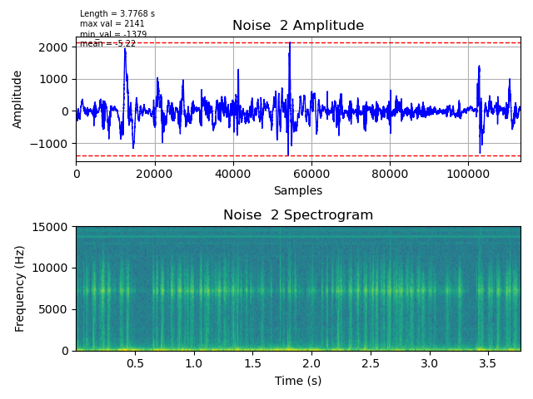
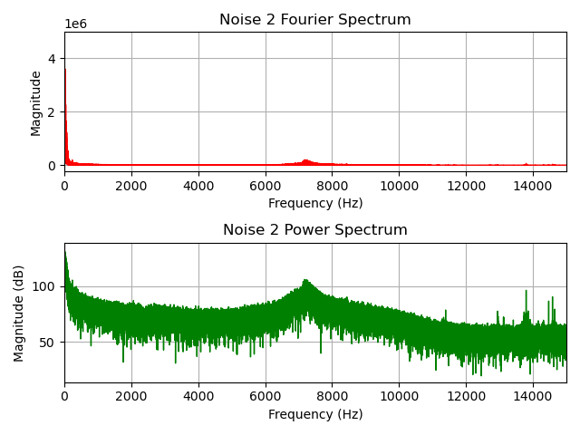
Noise 2:
Peak around ~7250 Hz

Slide 16
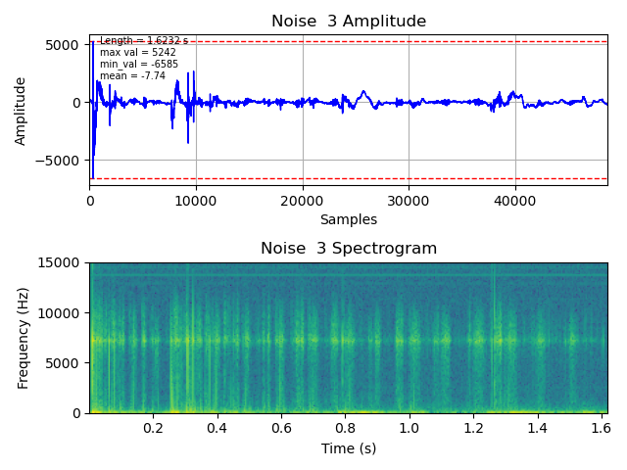
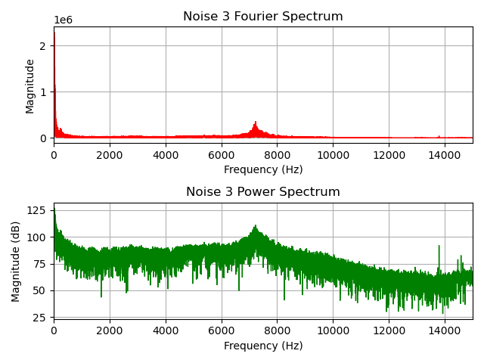
Noise 3:
Peak around ~7250 Hz

Slide 17
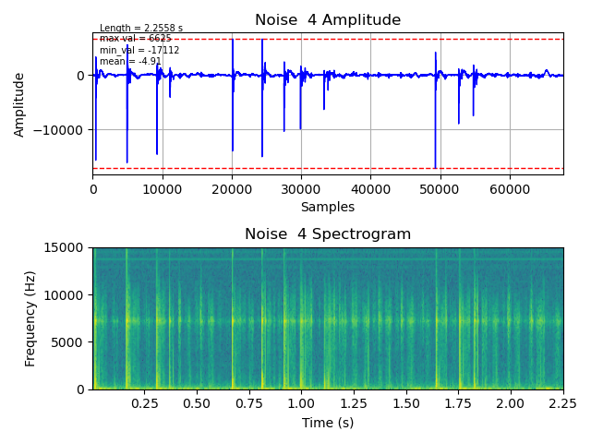
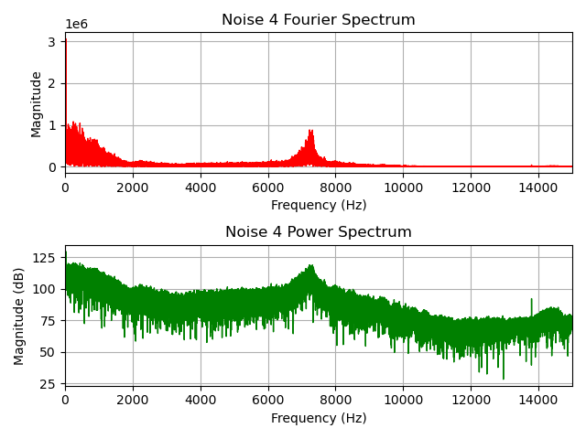
Noise 4:
Peak around ~7250 Hz

Slide 18
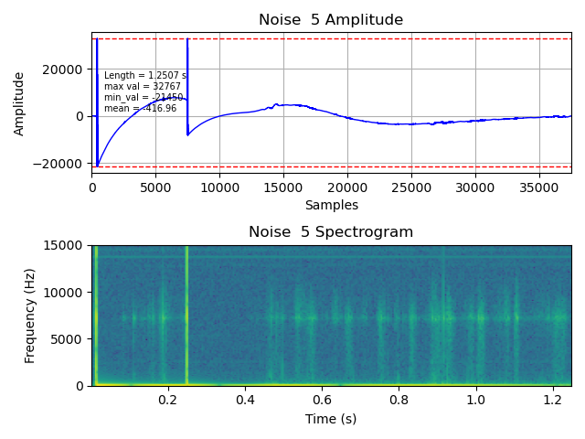
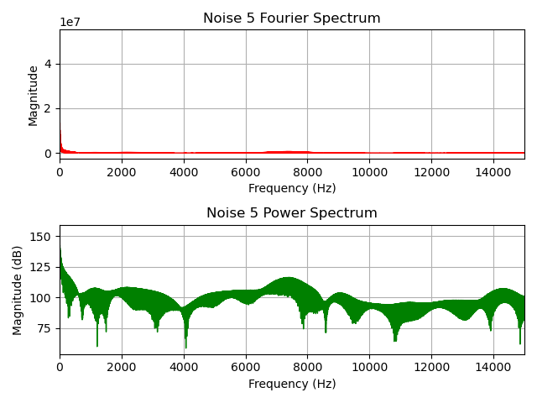
Noise 5:
Peak around ~7250 Hz

Slide 19
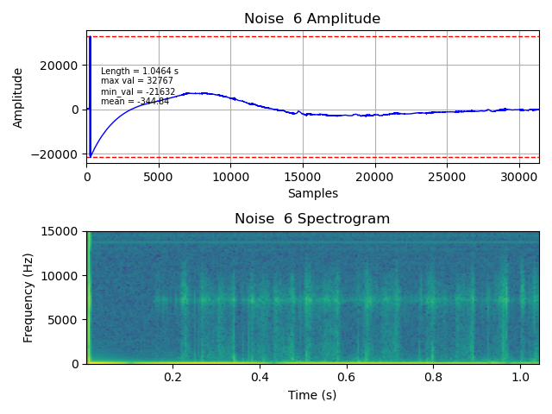
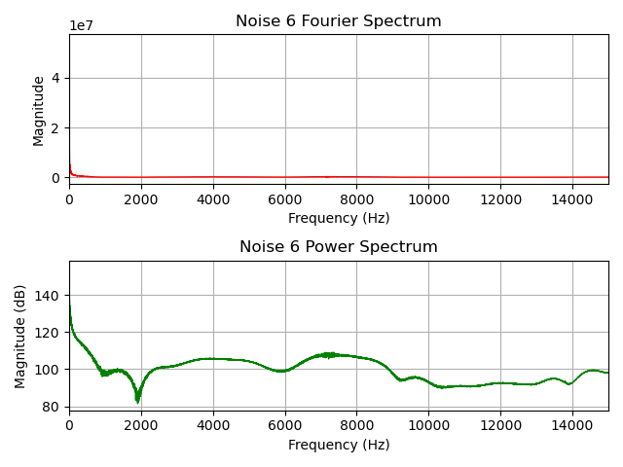
Noise 6:
Peak around ~7250 Hz

Slide 20
30 second clips of noise / quiet
(unfiltered)

Slide 21
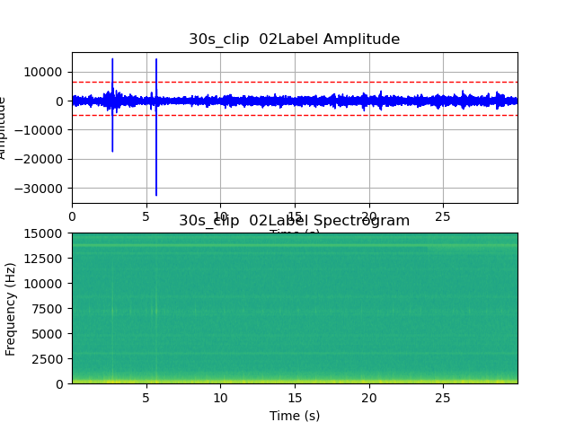
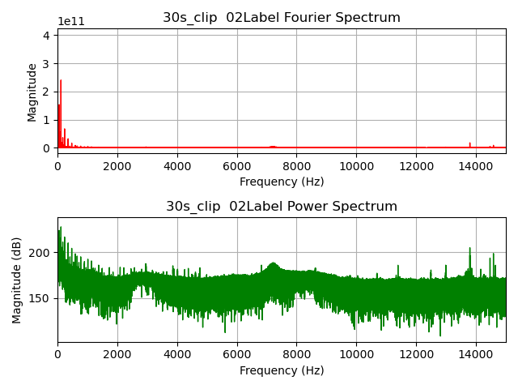
30s noise 1
Peak around ~7250 Hz

Slide 22
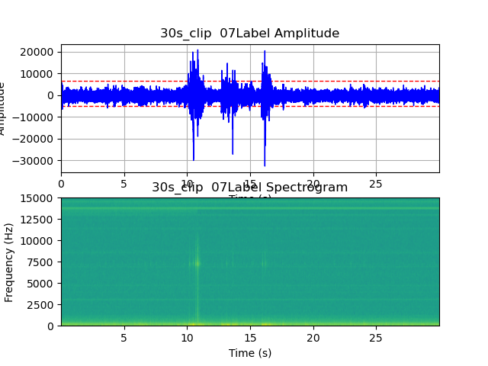
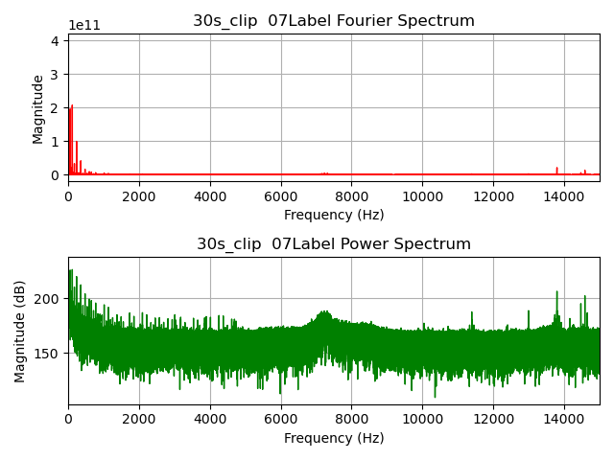
30s noise 2
Peak around ~7250 Hz

Slide 23
Quiet / Noise

Slide 24
Filtering on amplitude
Cut by 30 second chunks

Slide 25
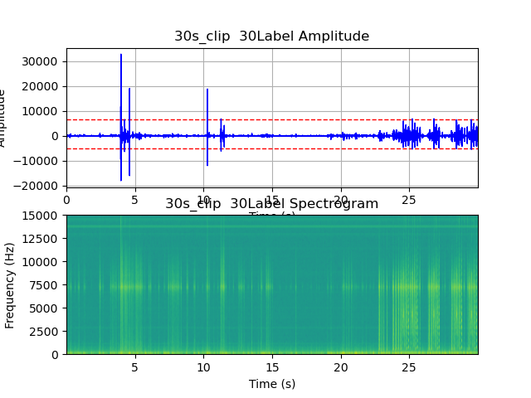
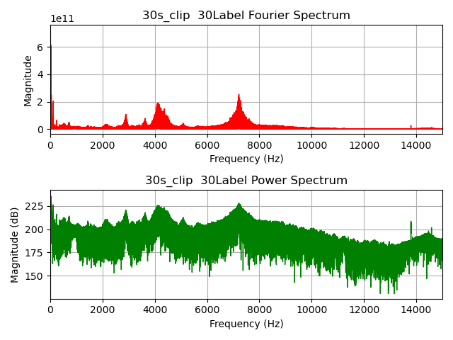
clip1
Syllables here

Slide 26
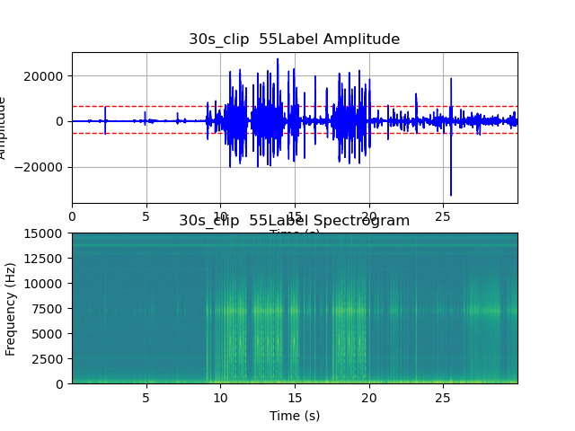
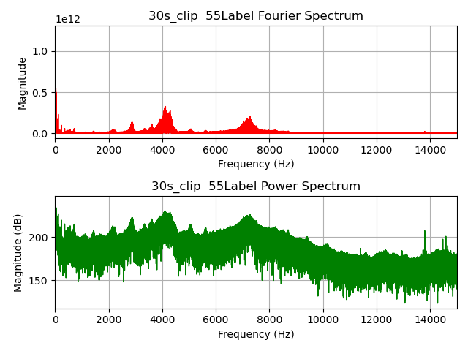
clip2
There is minimal noise in this clip, so the scaling is off.
Syllables here

Slide 27
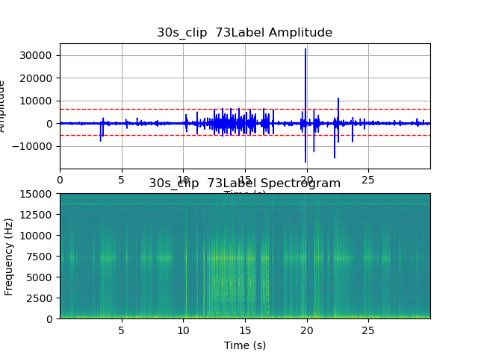
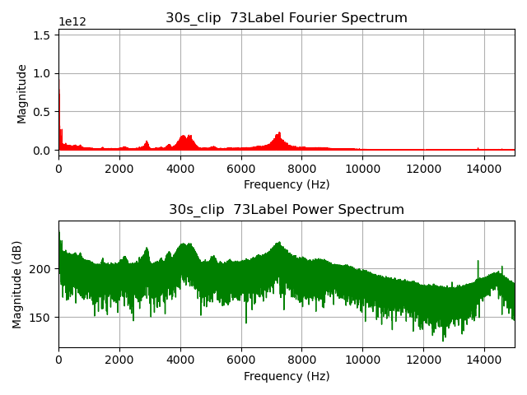
clip3
Syllables here

Slide 28
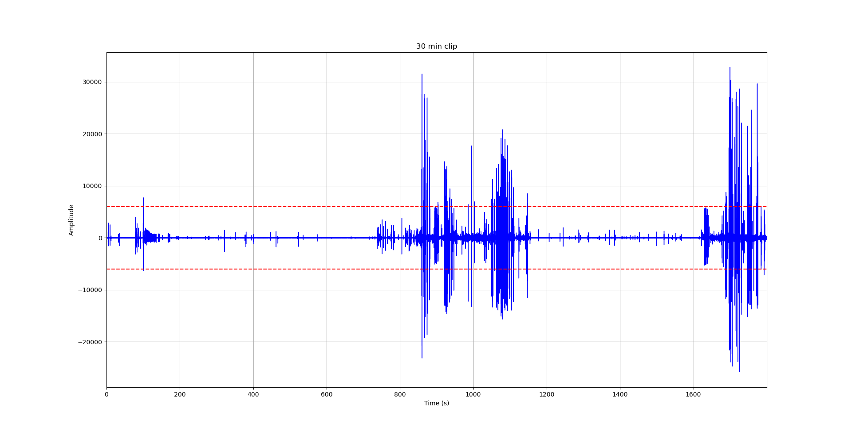
30 min clip1
Syllables here

Slide 29
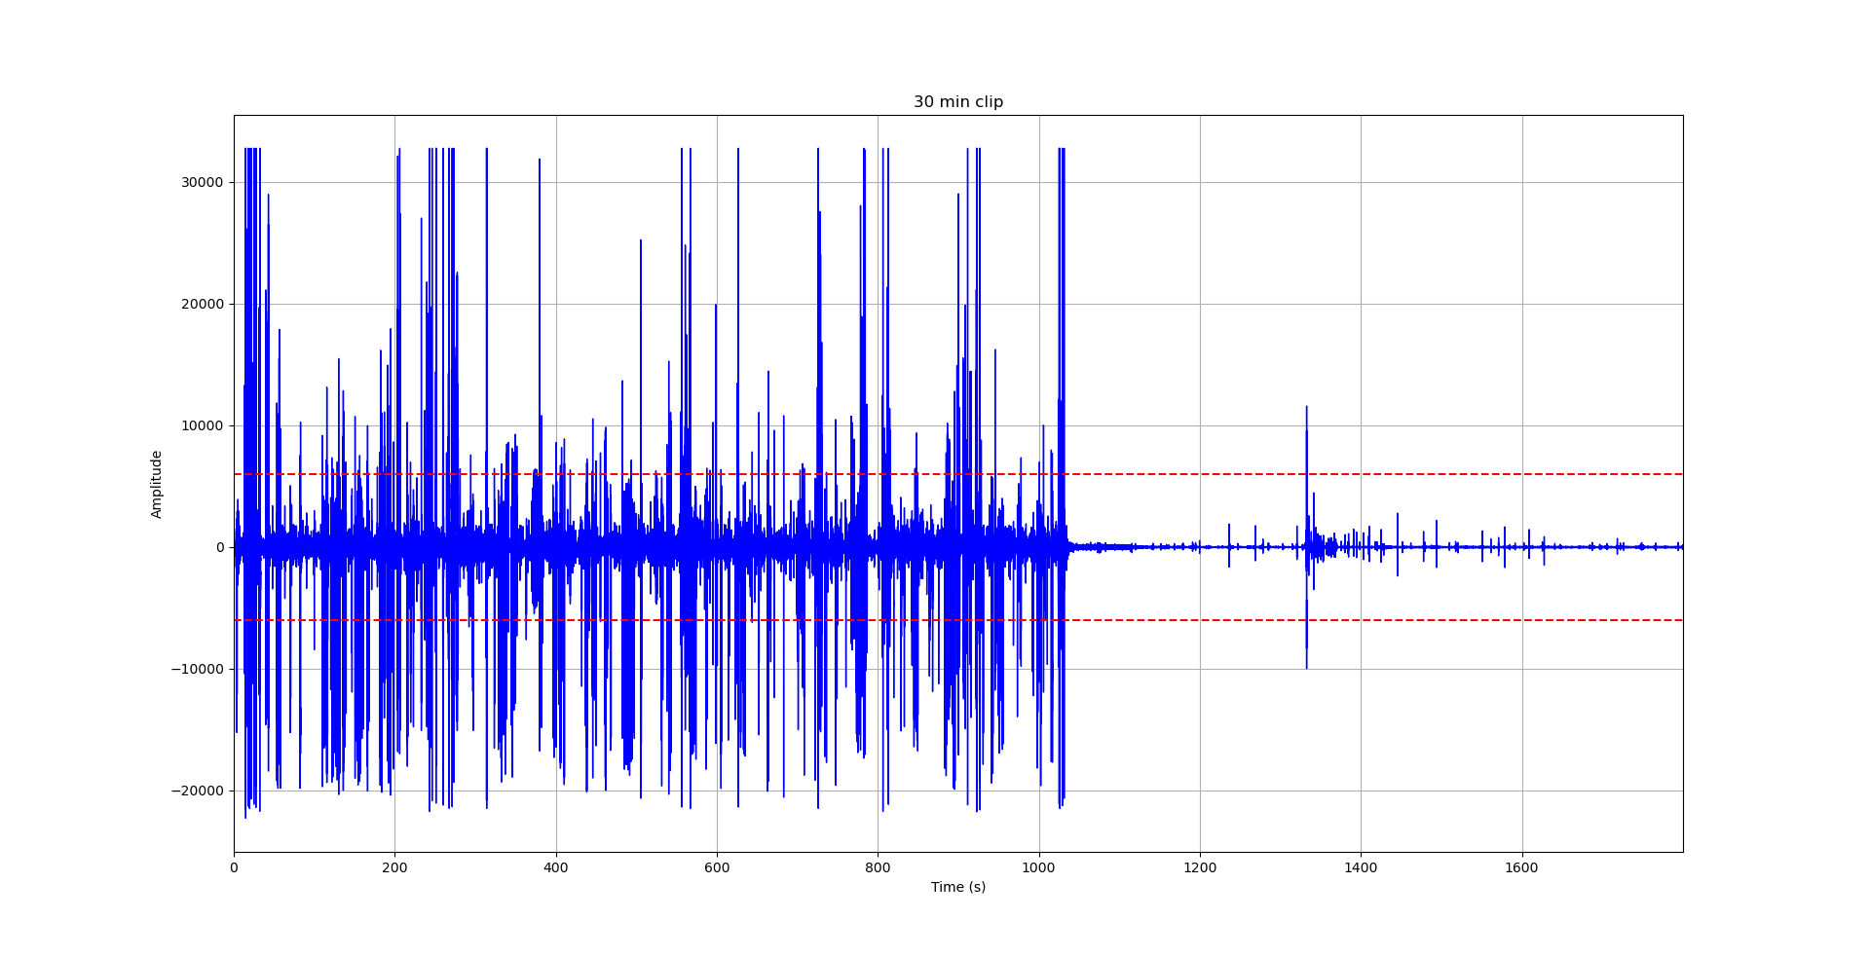
30 min clip2
Syllables here

Slide 30
Issues:
Cutting in consistent intervals (ex: 30s) is probably OK.
Risks cutting in the middle of a song
Clips may have significant amount of noise (may be problematic when filtering by Fourier spectrum).
Not the most efficient. 30s clip is ~3 MB, when the song we want is probably a few seconds ~ 100’s KB.
Tweetynet: Generally good at ignoring noise.
- However, not perfect.
- Optimal to minimize amount of noise in Tweetynet input to reduce chance of incorrect labeling.
To reduce risk of cutting in middle of song?
Cut in larger chunks (ex: 30 min) -> Tweetynet
- However, this is not very computationally efficient.
- Not optimal for Tweetynet
- Probably only a few seconds of song in the whole length
- .wav format: ~100 MB of audio, probably ~100’s KB of interest

Slide 33
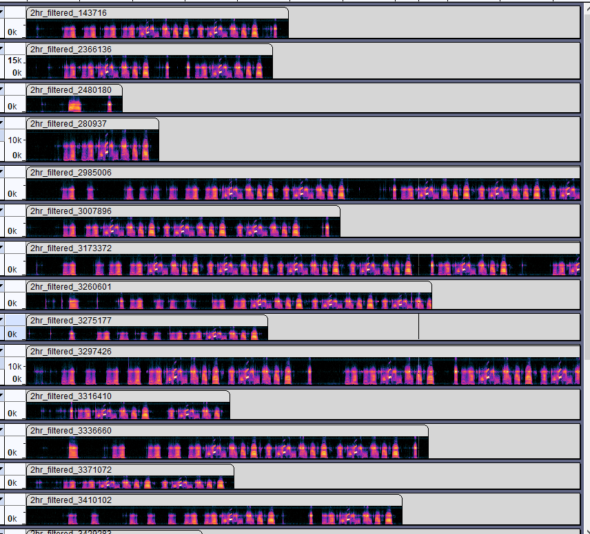
Alternative:
Step 1: Use a nonlinear method decide on where might be a “good place” to cut.
2: Filter based on amplitude.
3: Filter based off on Fourier / power spectrum.

Slide 34
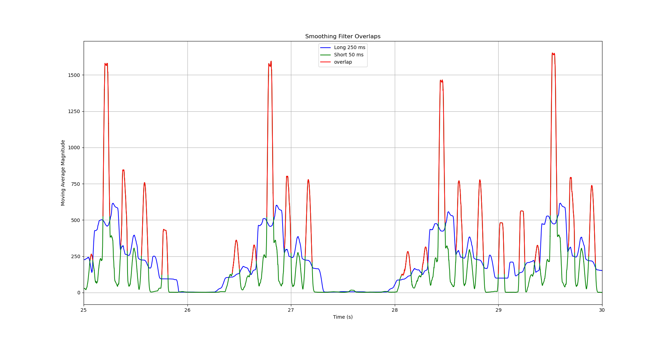
My method
Based on the overlap of 2 moving averages to generate a “mask”.
Drop section if length threshold is not exceeded
Merge section if section is within certain distance from another.
Then apply the mask to the waveform
These overlaps would be considered as 3 separate sections.

Slide 35
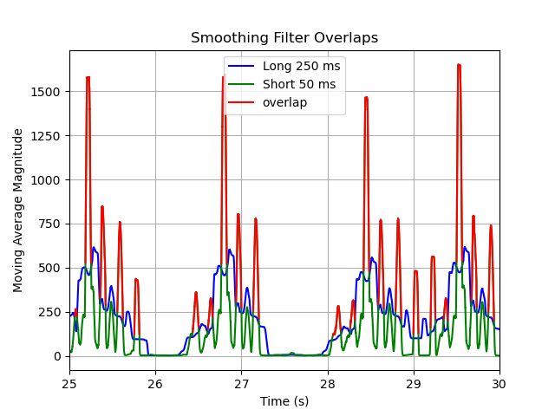
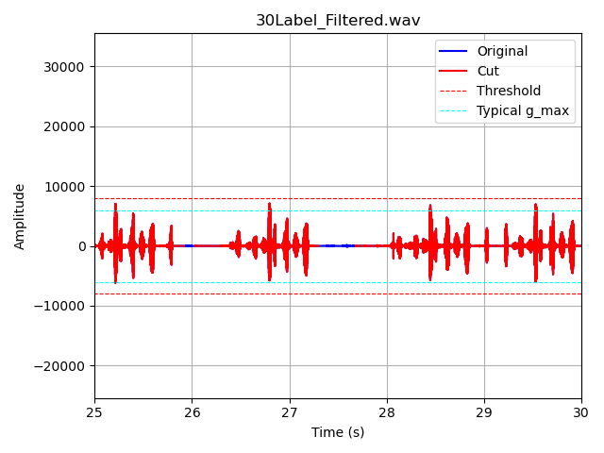
Apply mask to audio

Slide 36
Next step:
Since we know the average amplitude /typical power spectrum of our syllables. We can filter by amplitude / fft.

Slide 37
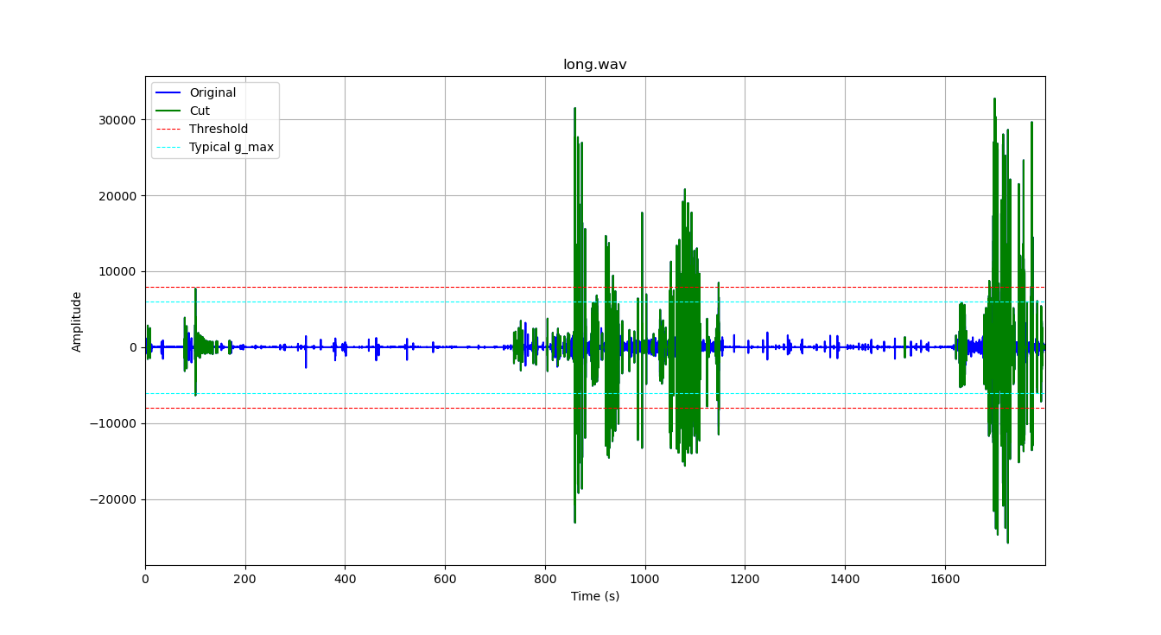
30 min clip 1, cut locations

Slide 38
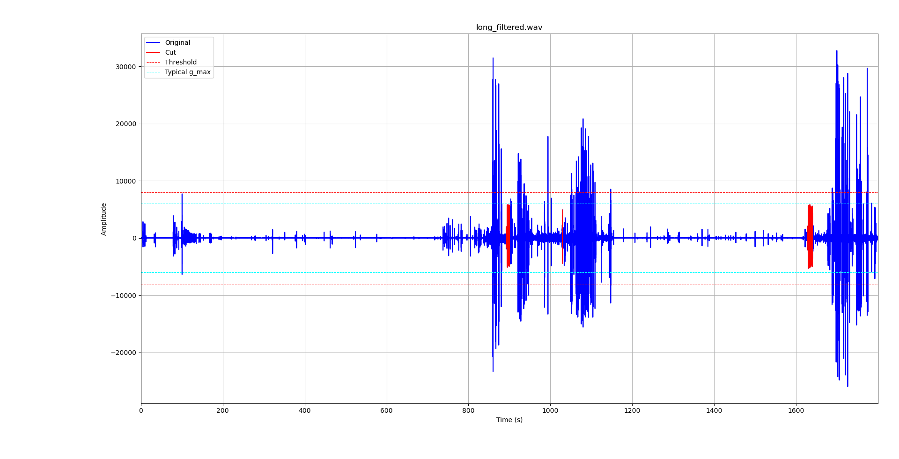
After amplitude / fft filtering

Slide 39
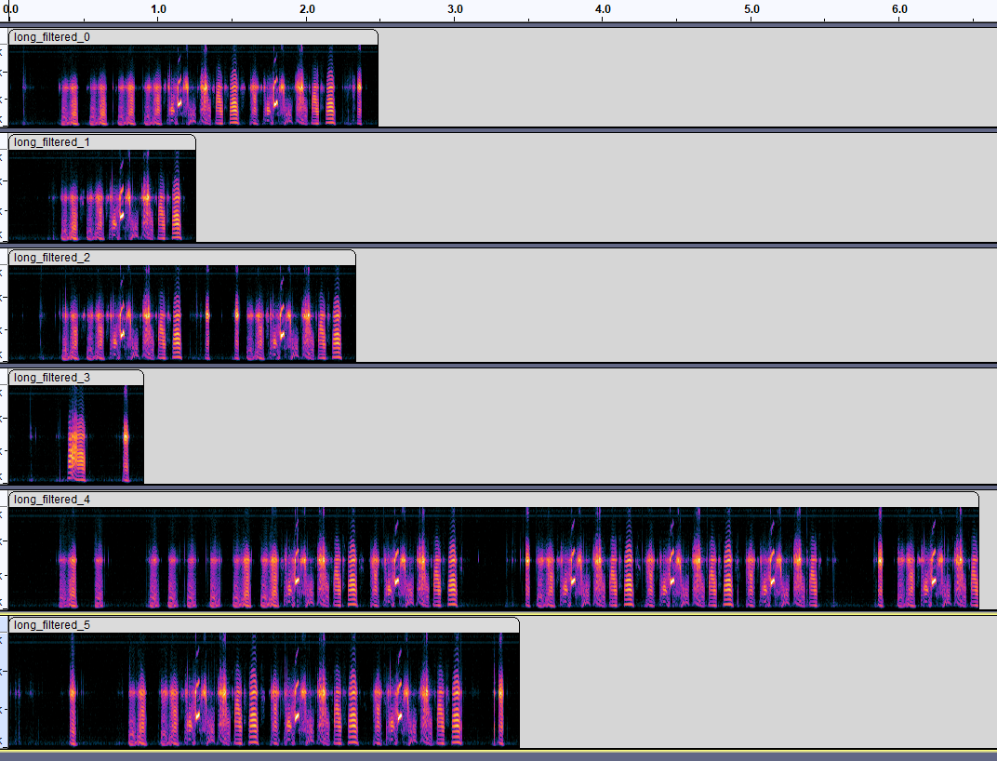
Results 1
Output did not miss any syllables
In original clip:
G= 14
H= 14
I= 14
J= 12
Total size of outputs:
998 KB

Slide 40
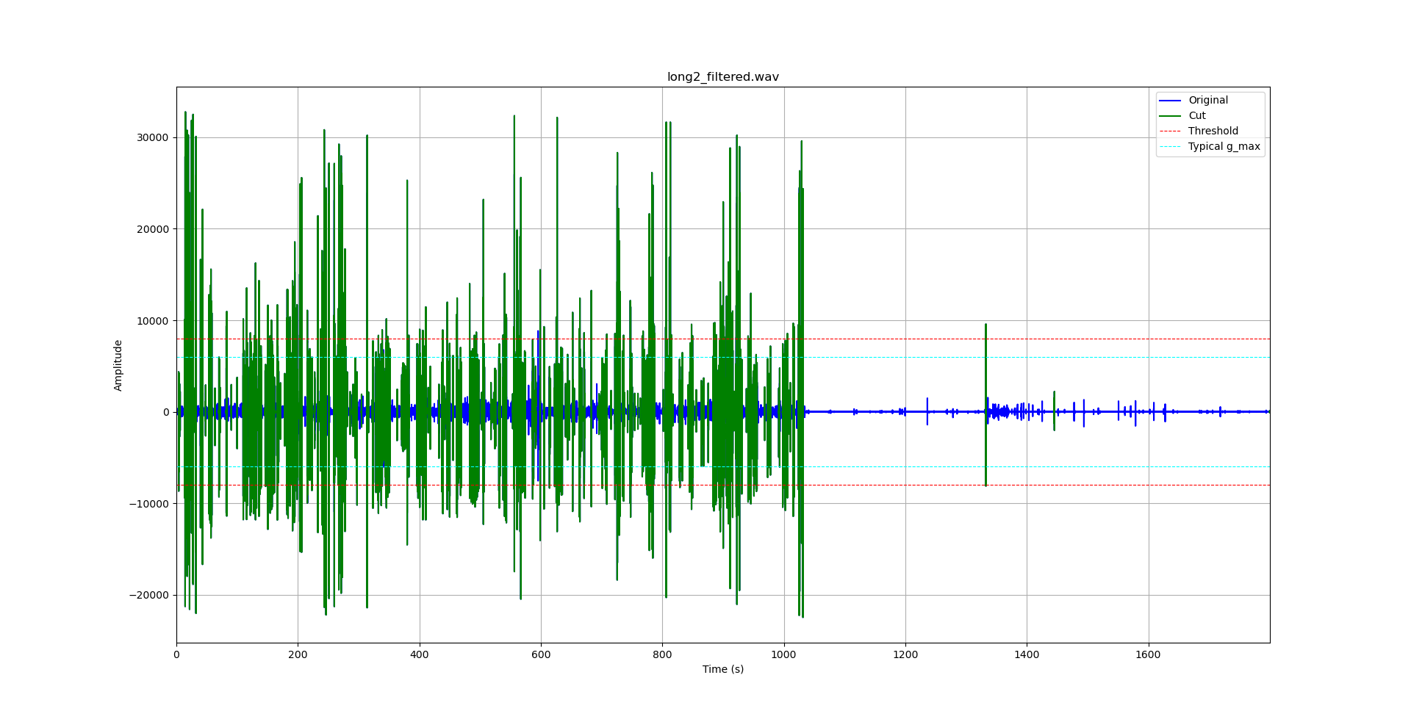
30 min clip 2, cut locations

Slide 41
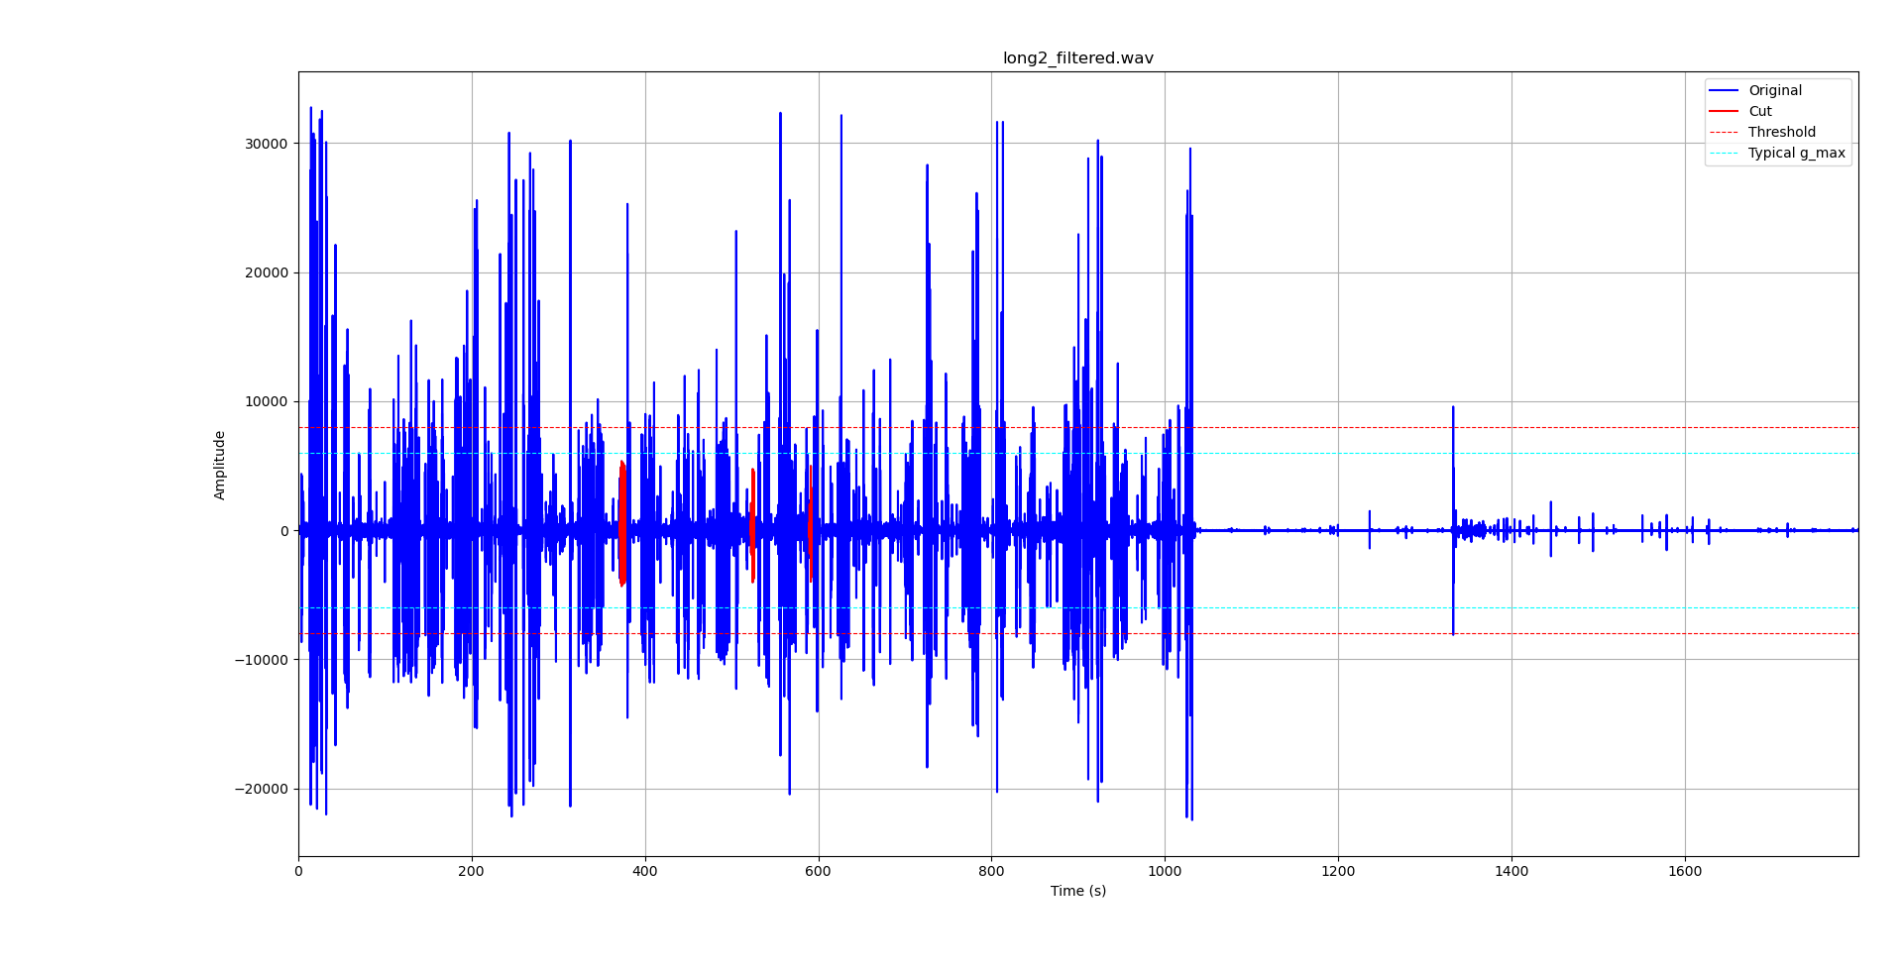
After amplitude / fft filtering

Slide 42
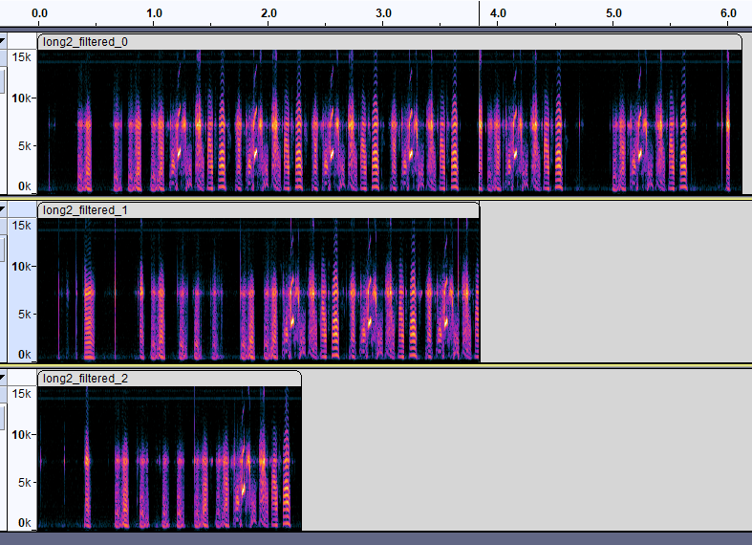
Results 2
Output did not miss any syllables
In original clip:
G= 10
H= 10
I= 10
J= 9
Total size of outputs:
712 KB

Slide 43
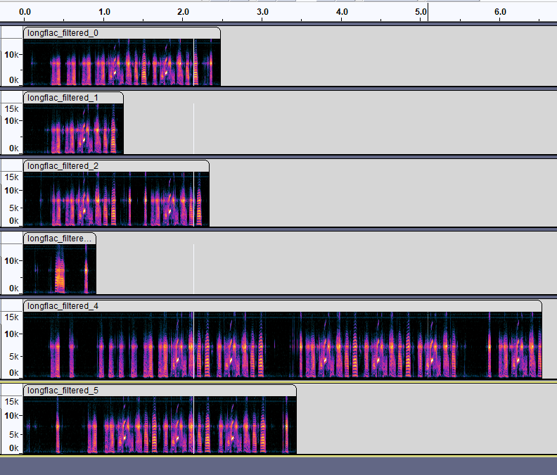
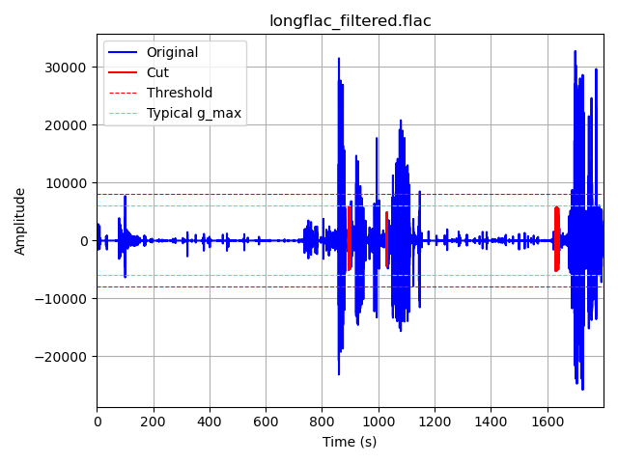
Output is same even with .flac as input
(Zetian records in .flac format)
However, output must be saved as .wav, (Tweetynet doesn’t accept .flac).

Slide 44
Results for 2 hour .flac file:
Output did not miss any syllables
In original clip:
G= 52
H= 52
I= 52
J= 47
Total size of output:
3.64 MB
The index of the audio is known = can map back to original (unfiltered) audio.

Slide 45
Methods continued…
Benefits of my algorithm:
Achieves nonlinear cutting of audio signal.
Reduces chance of cutting in the middle of a syllable.
Noise is basically “ignored”.
Forwards-backwards filtering.
No delay or phase shift.
Exact position of outputs relative to original are known.
= can easily map back to unfiltered audio signal.
Scalable. ~100’s of KB (vs. ~3 MB’s of 30 second clip).
Using 30s clips: ~10 MB / 30 min. 20 hrs of recordings = ~300-400 MB
Using my method: ~1 MB / 30 min. (reduction of x10).
Applicable to other animals?
Budgie, singing mouse.

Slide 46
Drawbacks
Requires additional testing.
The most I tried is 2hrs clip
Edge cases?
Some optimization required.
numpy has significantly less memory overhead.
Not a real time method.
Alternatives: Hilbert Huang Transform?
Linear phase filter (instead of forwards/backwards filtering)
Delay is known

Slide 47
Future steps
Refactor the source code (= optimize / easy to read).
More testing required.
-> Apply this to the full audio signal (22 hrs, 44 min long)
= efficient Tweetynet pipeline to analyze Finch song.

Slide 48
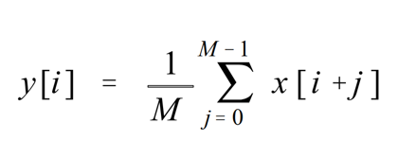
Moving Average:
Average of surrounding samples:
P_long = 250 ms * 3 samples / ms = 750 samples.
P_short = 50 ms * 3 samples / ms = 150 samples.

Slide 49
Moving Average:
Example:
Given vector a = [ 3 6 9 6 12 ]
3 point smooth filter b = [ ⅓ ⅓ ⅓ ]
conv(a,b) = [ 1 3 6 7 9 6 4 ]

Slide 50
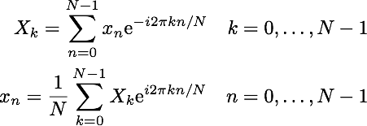
Fast Fourier Transform-based convolution
Standard convolution has O(n^2) complexity
OK for short signals (ex: 30s = 900,000 samples)
However, not scalable.
Fft based convolution has computational complexity of: O(n log2 n)
Much more efficient for longer signals (ex: 30+ minutes).

Slide 51


Preprocessing Filter Choice:
8th order Chebyshev II filter
Steeper transition band than Butterworth,
Preserves passband while attenuating stopband.
Cutoff frequency = 350Hz (can change this if necessary)
Minimum Attenuation = 30 dB
Implemented using forwards-backwards-filtering

Slide 52
Data structure.
Data structure of final output:
[ nan nan nan … # audio # … nan … nan… # audio # nan … nan ]

Slide 53
Reference:
Sandsten, Maria, Mareile Große Ruse, and Martin Jönsson. "Robust feature representation for classification of bird song syllables." EURASIP Journal on Advances in Signal Processing 2016 (2016): 1-16.
https://asp-eurasipjournals.springeropen.com/articles/10.1186/s13634-016-0365-8

